Slide 1
Library Management System
Faculty Initial – Itn Course – CSE- 311 Section - 3 Group – 3 Name & ID i. Ahmed Faizul Haque Dhrubo ----- 2111026042 ii. Mohammad Akib ---- 2012574642 iii. Mohammad Tarem ---- 2021308642

Slide 2
Title and Content Layout List
Description
ER Diagram
Relational Table
Technology

Slide 3
Introduction: It is a library website where student can read books and rent books for short time .If they didn’t return book on time they will be fined. Here student can issue books by their choice after getting approval then the books will be added. If admin want he can delete books. Here students can chat with admin and discuss about their problem.
Sometimes when I go to bookshop or even in Nilkhet I cannot find all books which I need. Even I found them their prices is too much which not affordable to us easily.

Slide 4
So, after suffering this type of problem I realised that I should build a website so my friend can easily read or borrow books from this website. By this way they can save their time and also save their money which belong to middle class family. If we get sufficient time and enough resources we will publish this website for everyone .Which is make our community more stronger.

Slide 5
Proposal
➔Admin i. Login: Admin must need e unique password & username for login website. If any of them didn’t match admin can not login website. Ii. Sign-up : If admin didn’t open any account he must need to register first then admin can login
➔Student i. Login: Every student must need to Unique Password & username.
ii. Sign-up : If any student didn’t have any account he or she must need to register first. ➔ Books i. Add Books: If student need any books and he/she need then he/she can add them .Admin can also add them.

Slide 6
ii. Delete book: If admin want he/she can delete books but students cannot delete books. iii. Issue-book: Here students can issue book by his/her choice .After admins approval books will be added.
Feedback
Here students can give their opinion and admin can see their name and opinions.
➔Picture Here students and admin can upload their photo. ➔Chatting Here students can discuss their problems to admin and admin can solve those problems instantly.

Slide 7
Admin
Add Book
Login
Update Profile
Index Page
Book page
Delete book
Student
Registation
Student Info
Issue_Book
Expire Date calculte
Admin Profile
Chatting With Student
Feedback

Slide 8
Student
Login
Update
Index
Book
Feedback
Admin
Registration
Add book
Issue_book
Expire book
Chatting

Slide 9
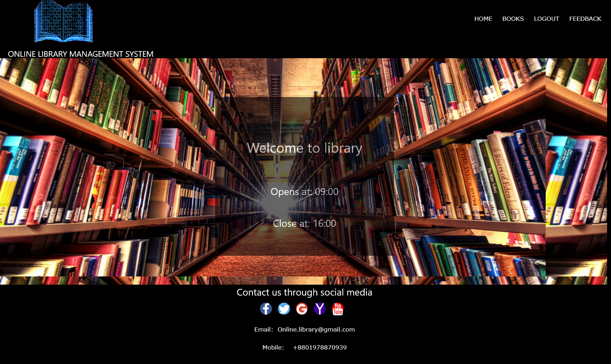

Slide 10
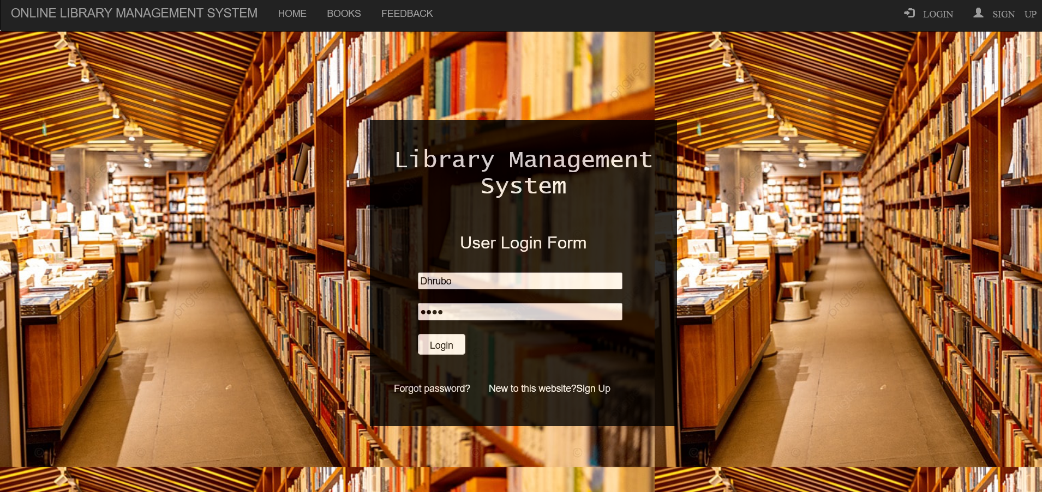

Slide 11
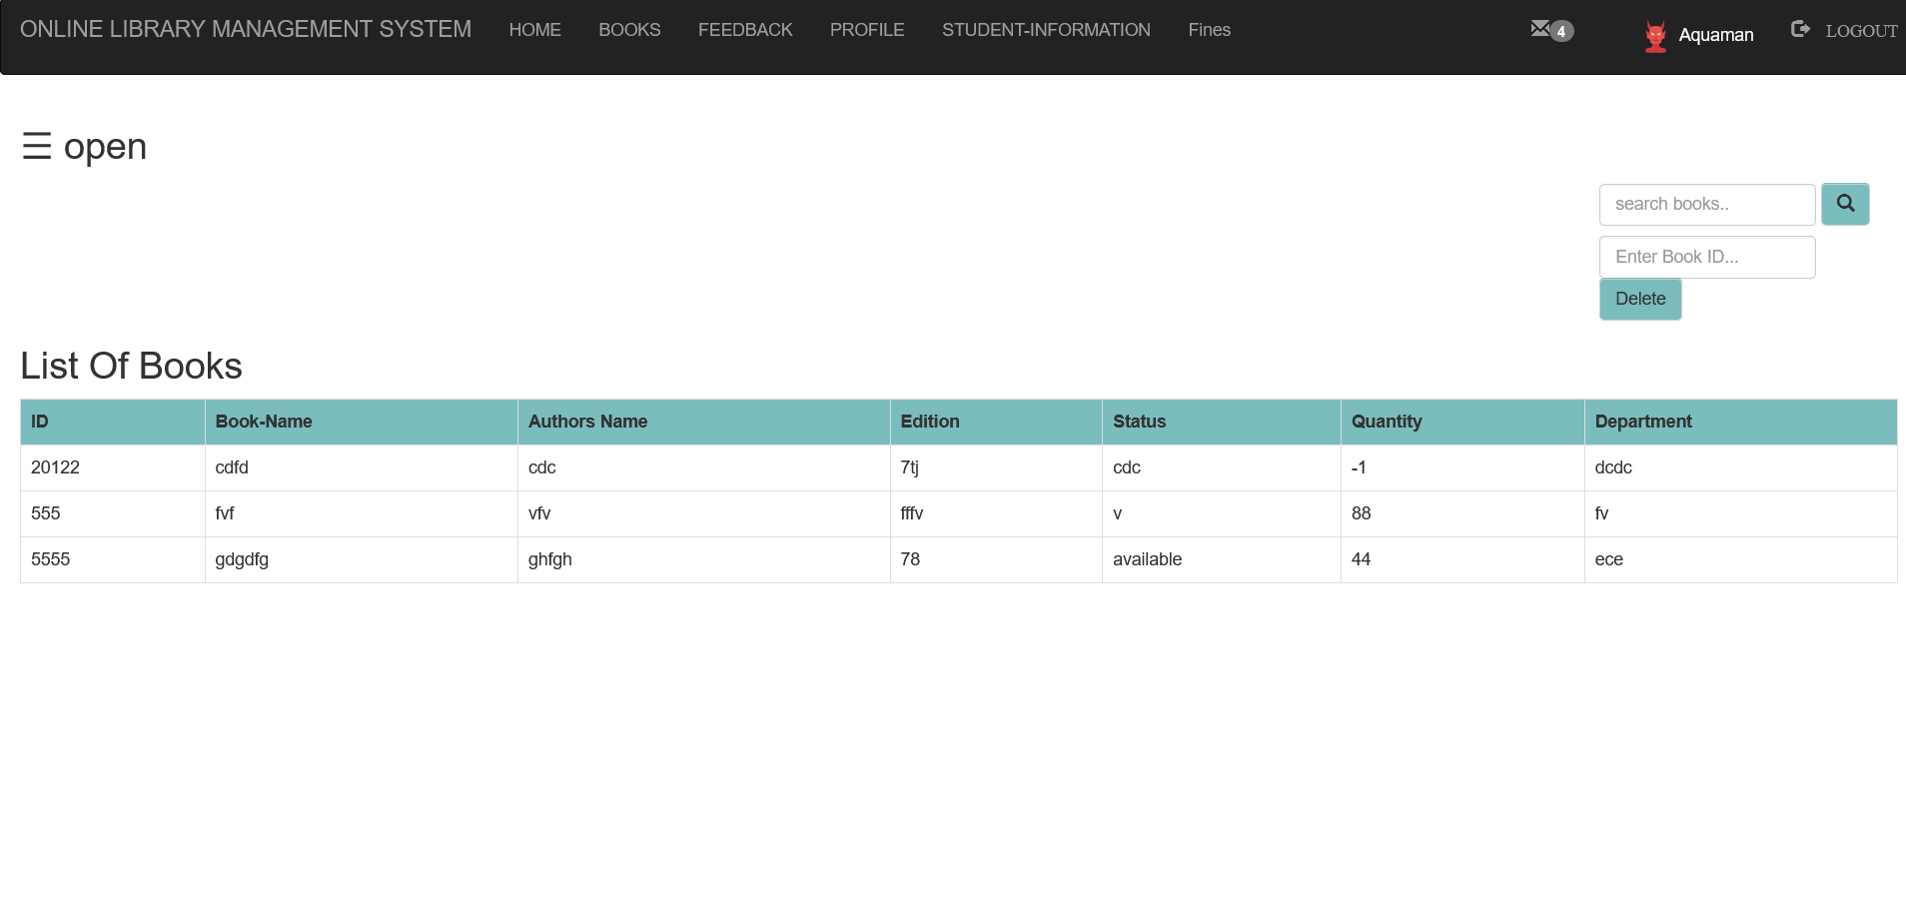

Slide 12
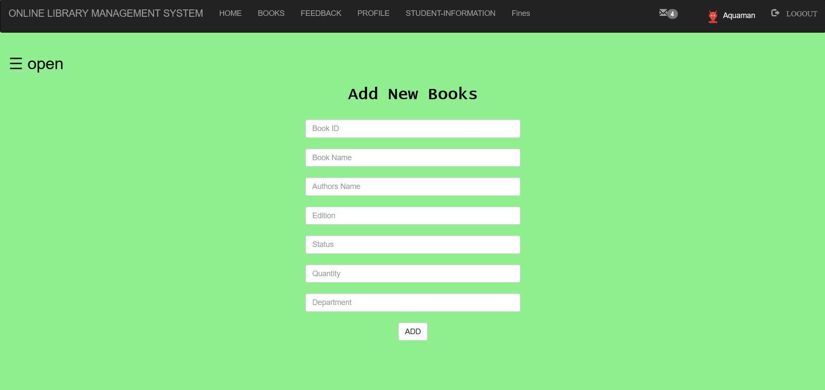

Slide 13
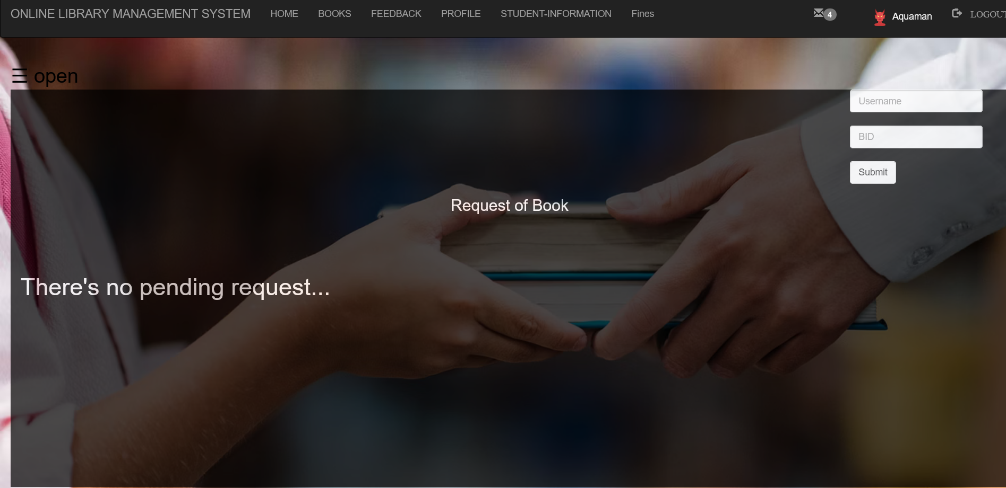

Slide 14
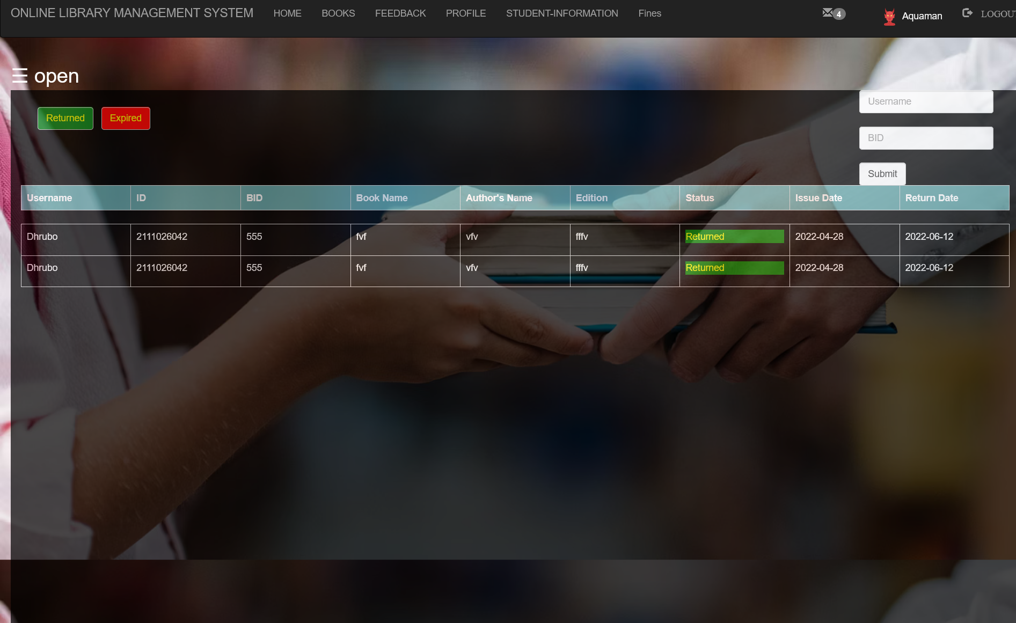

Slide 15
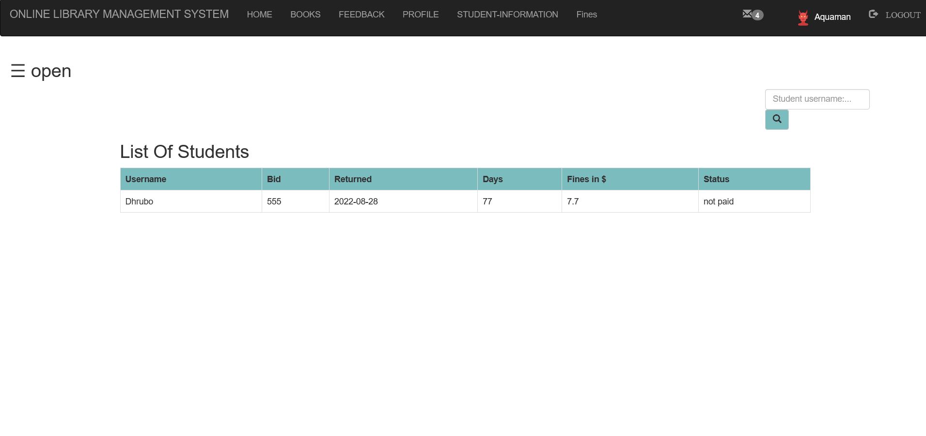

Slide 16
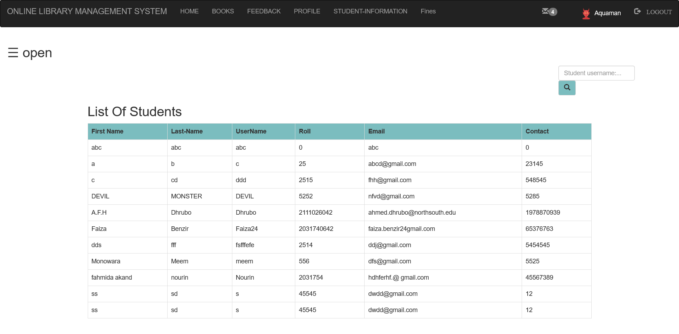

Slide 17
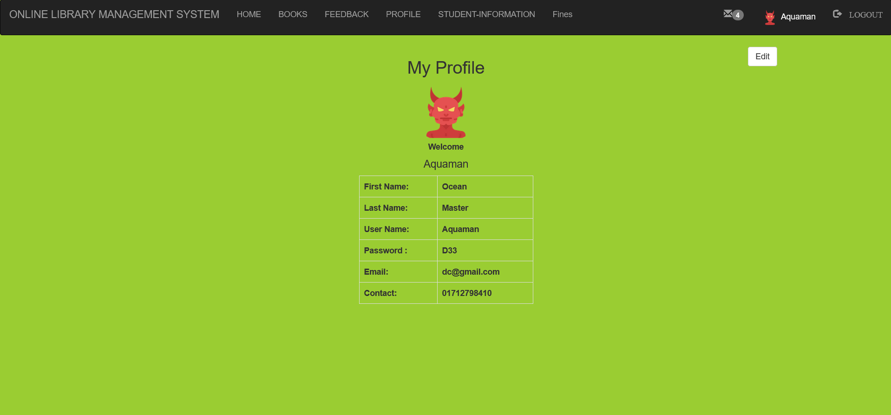

Slide 18
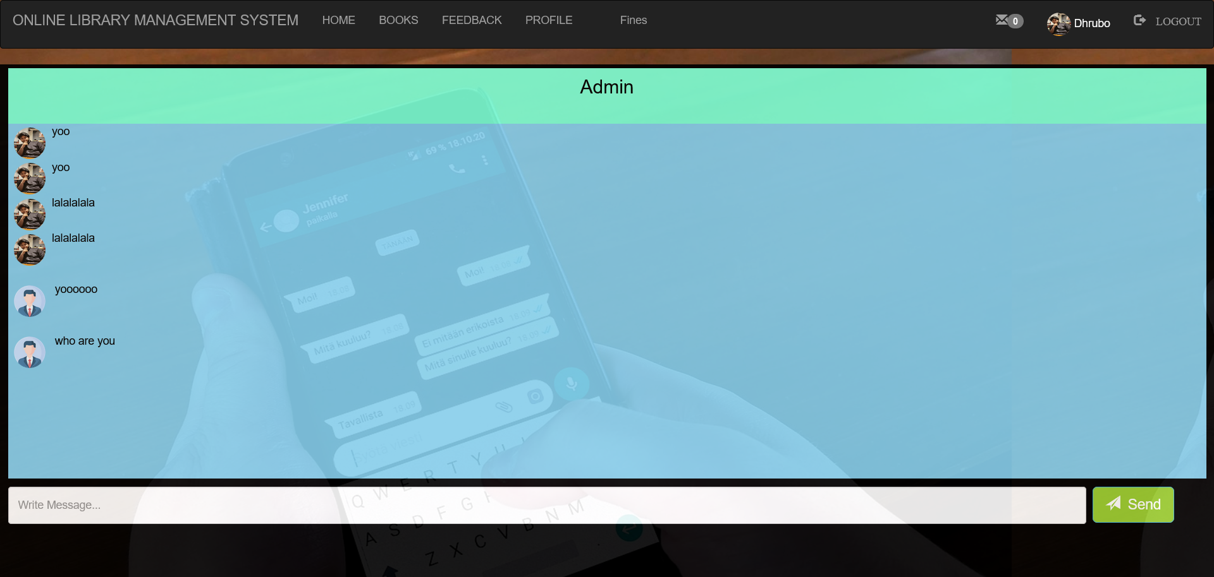

Slide 19
➔Technology: We used here Php, javascript, html, css , mysql . Css,html,JavaScript for frontend and php,javascript for backend. ➔ Discussion: Write now go to bookshop for buying books kill ours lot of time. By using website we can read books easily. It not only save our money it also save our time and space. We always did not find all books in bookshop but from website we can download all kind of books at free of coast. Here we focused to solve those problems. Here were design this website very easily so anybody can easily use this website.

Slide 20
Strong Entities: Admin , Student , Book , Feedback ,Report, Authentication Admin : Pic , Name , Password , Email , Username(PK) , Phone (FK), St_ID_NO(FK) , b_ID(FK) , r_username(FK) , f_username(FK) Student : ID NO(PK) , Email , Pic , Last Name , First Name , Username , Password , Phone(FK) Book : ID(PK) , Title , Authors , Edition , Department Report : Username(PK) , Return Date , Issue Date , Book ID
Authentication: OTP verification (PK) , Password , Username

Slide 21
Relationship ➔ Student – Book have ( Many to Many) ➔ Student – Authentication(Many to Many) ➔ Admin – Authentication (Many to Many) ➔ Admin – Report (One to Many) ➔ Student – Admin (One to Many) ➔ Admin – Book (One to Many)

Slide 22
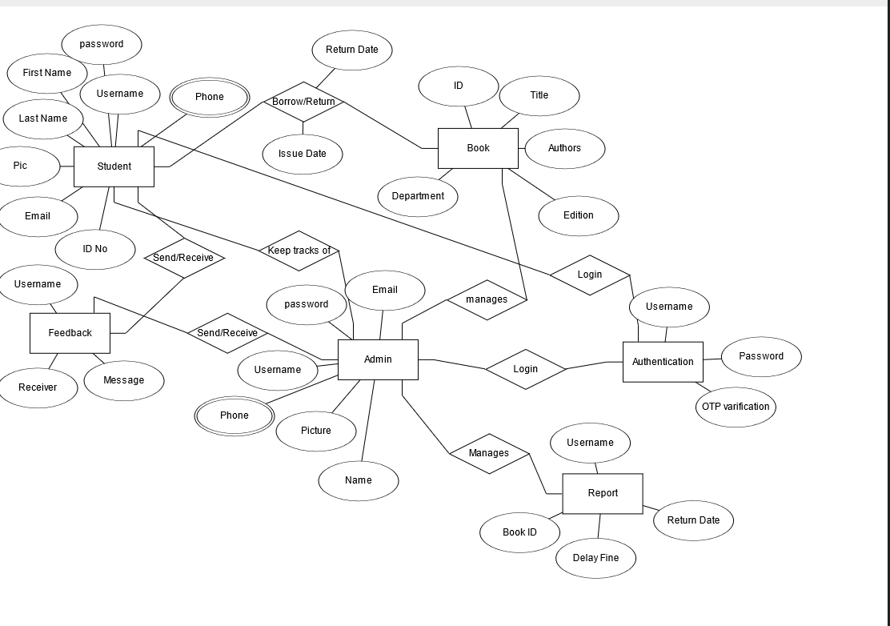
ER-Diagram

Slide 23
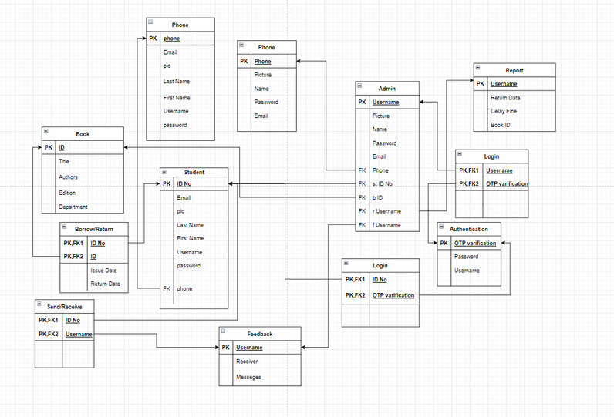
Relational Table

Slide 24
Contribution
Ahmed Faizul Haque – Backend Mohammad Akib – Frontend Mohammad Tarem - Database

